Slide 1
TELECOM CHURN domain oriented case study

Slide 2
Problem statement
CUSTOMER LEVEL DATA OF TELECOM COMPANY ANALYSIS

Slide 3
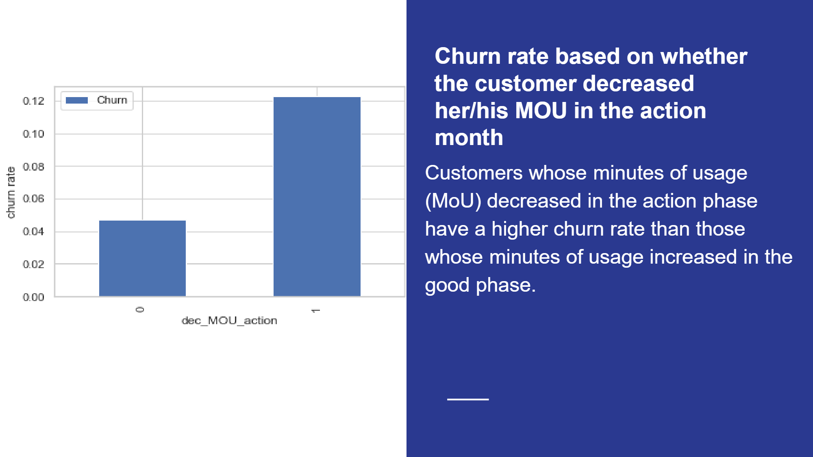

Slide 4
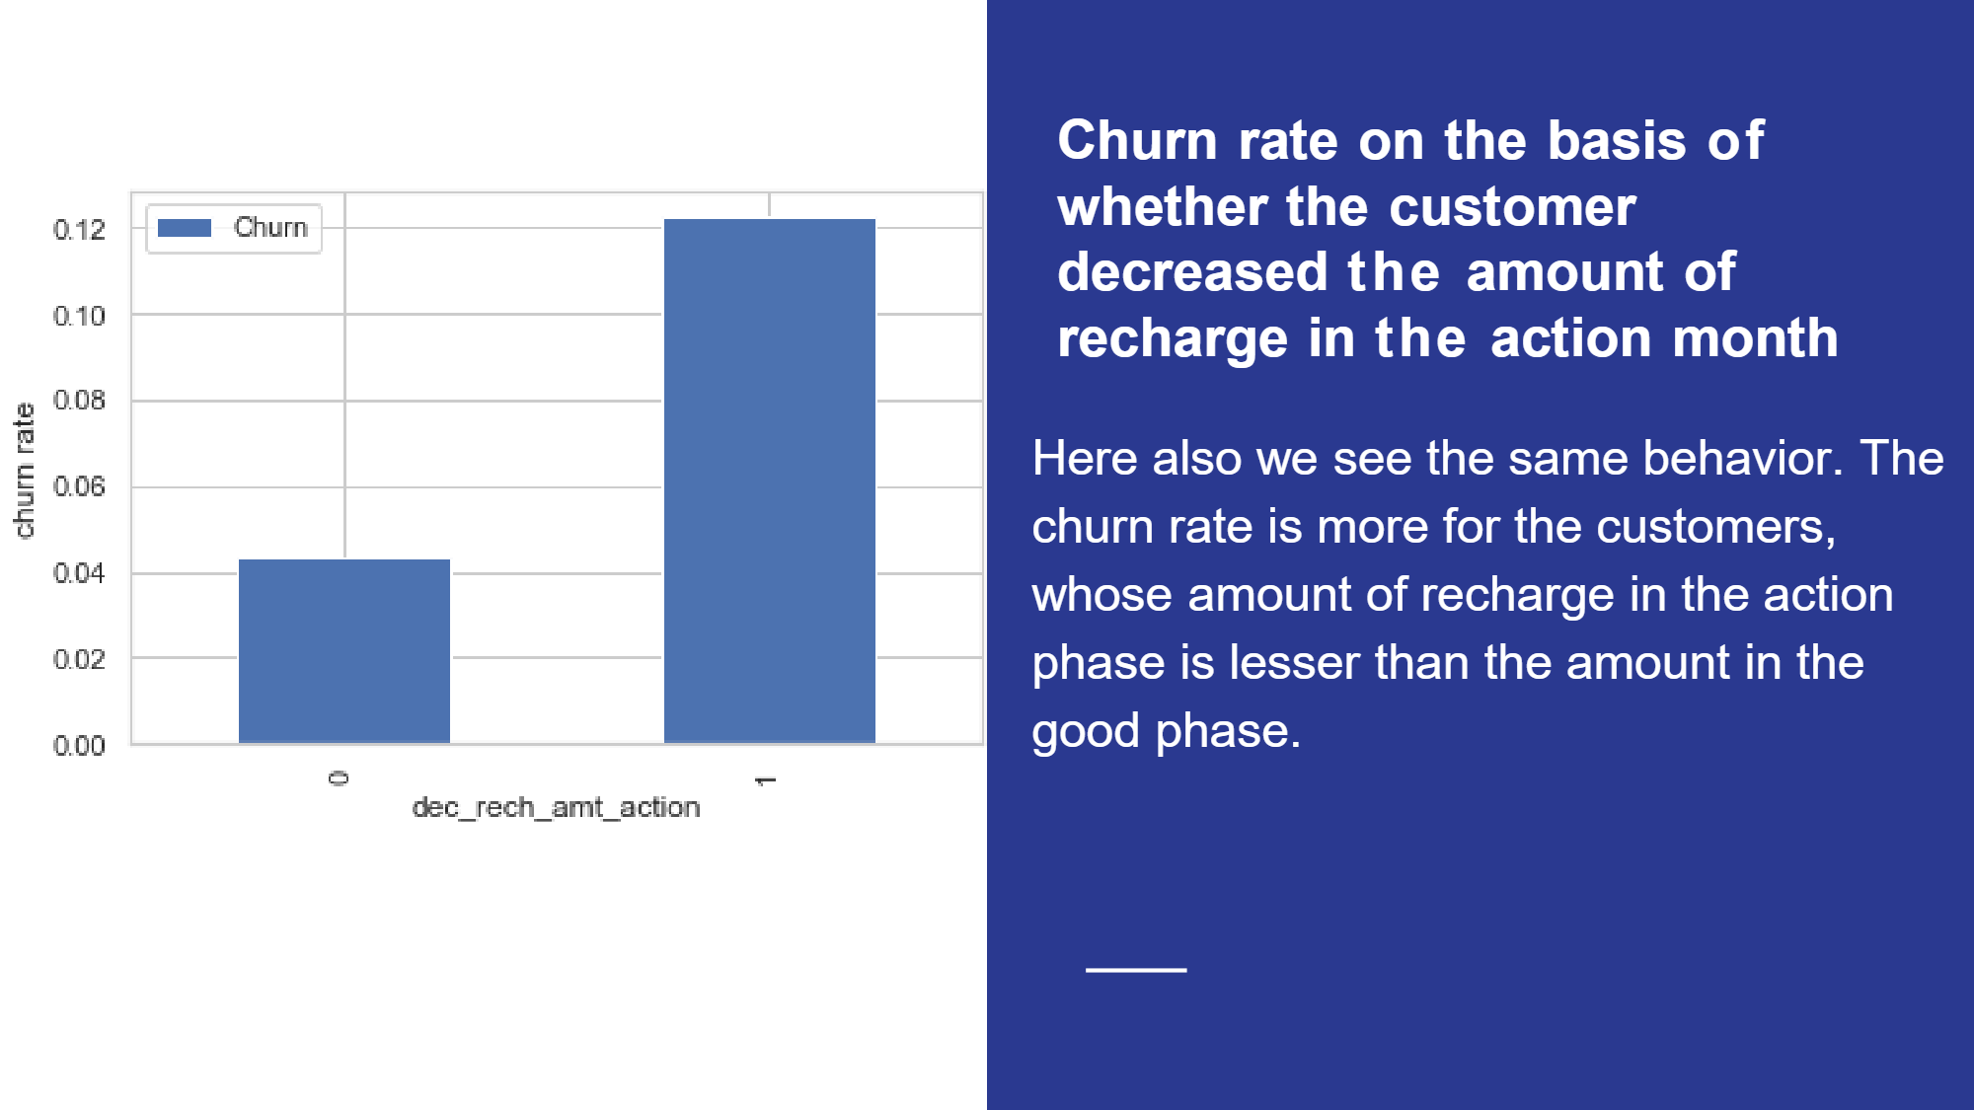
THIS GRAPH SHOWS THAT CASH LOANS ARE MORE FREQUENT RATHER THAN REVOLVING LOAN

Slide 5
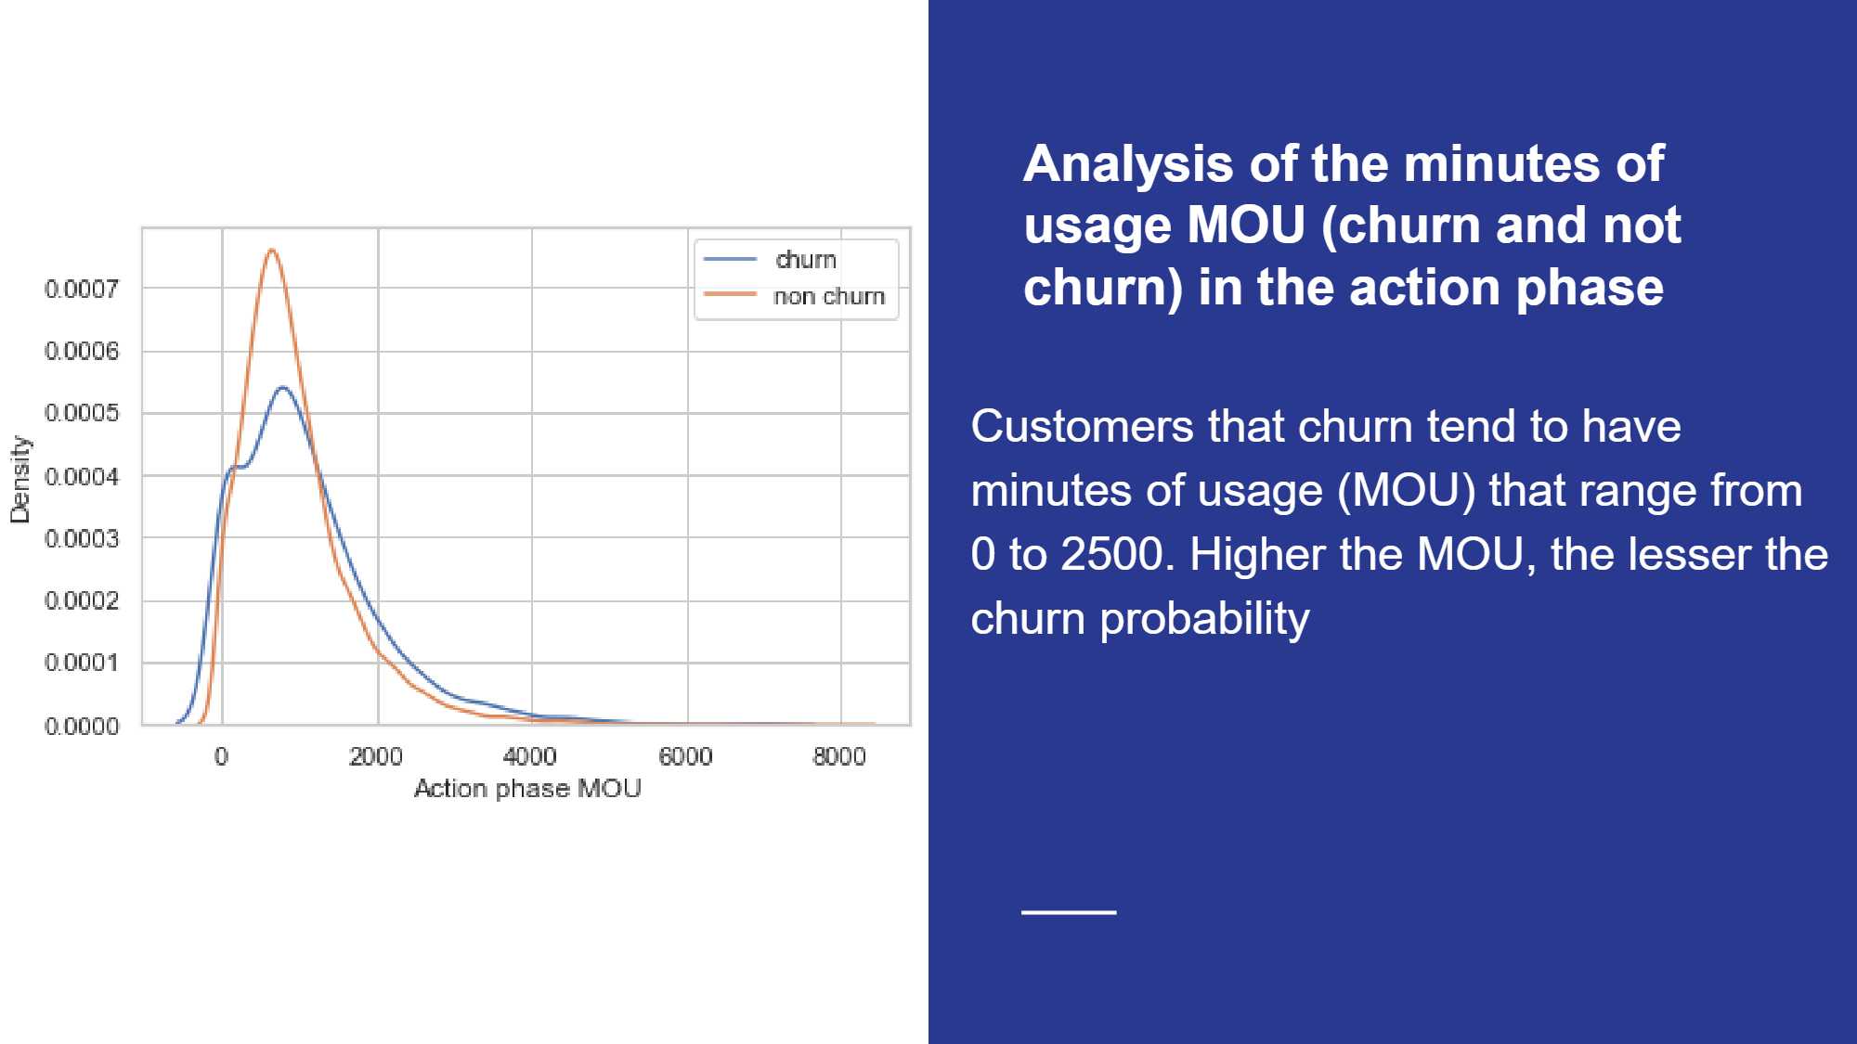

Slide 6
Thank you
KAMLESH SRIVASTAVA
GCO C7

